Slide 1


CliMAF Earth System Model Evaluation Platform
Evaluating/comparing a set of simulations/models on Ciclad
Introduction

Slide 2
The C-ESM-EP
Definition
A predefined – community validated (IPSL-CNRM-CERFACS) set of evaluation diagnostics by component/thematic
an efficient way to systematically compare results of different simulations while benefiting from ways to finess the diagnostics (choosing the periods for a set of diagnostics, controlling the plot parameters…)
a front html page with links to the html pages of the atlases of the different components/thematics.

Slide 3
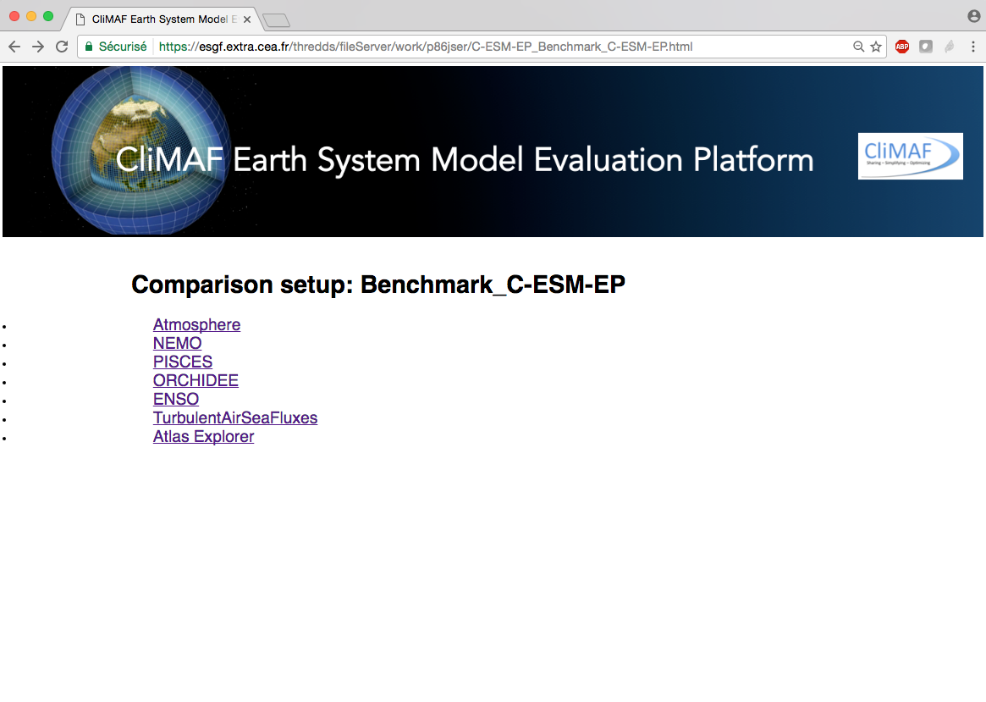
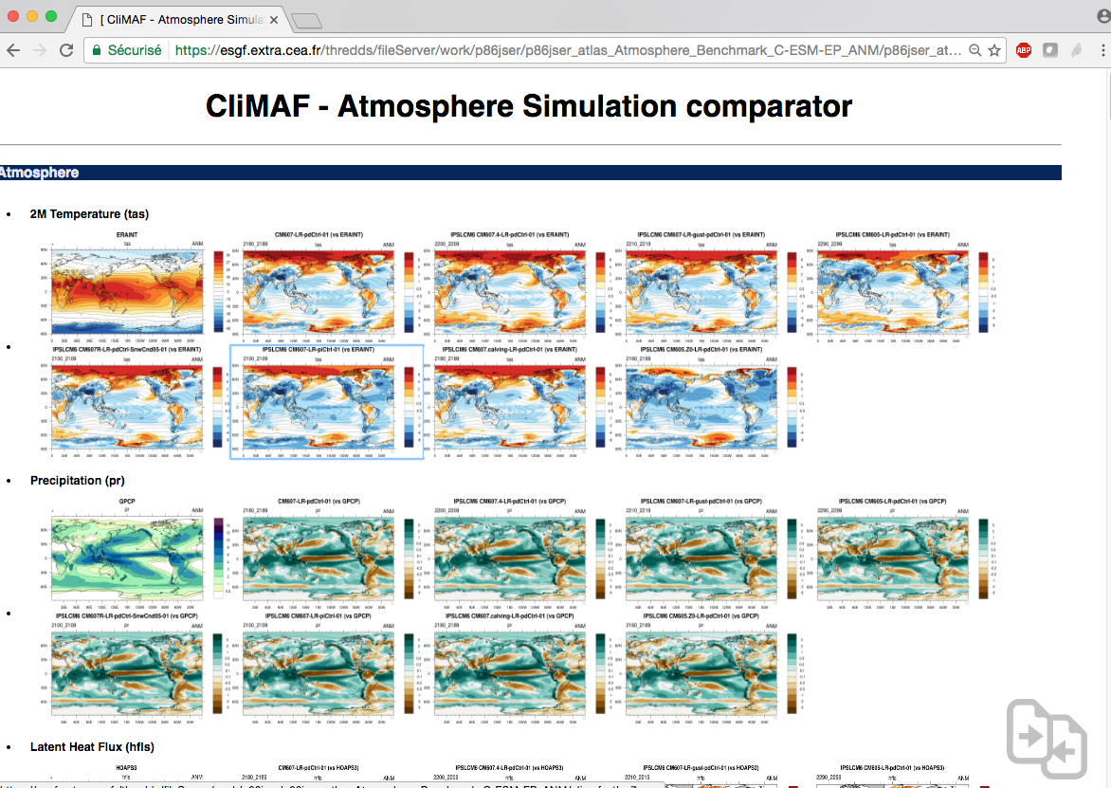
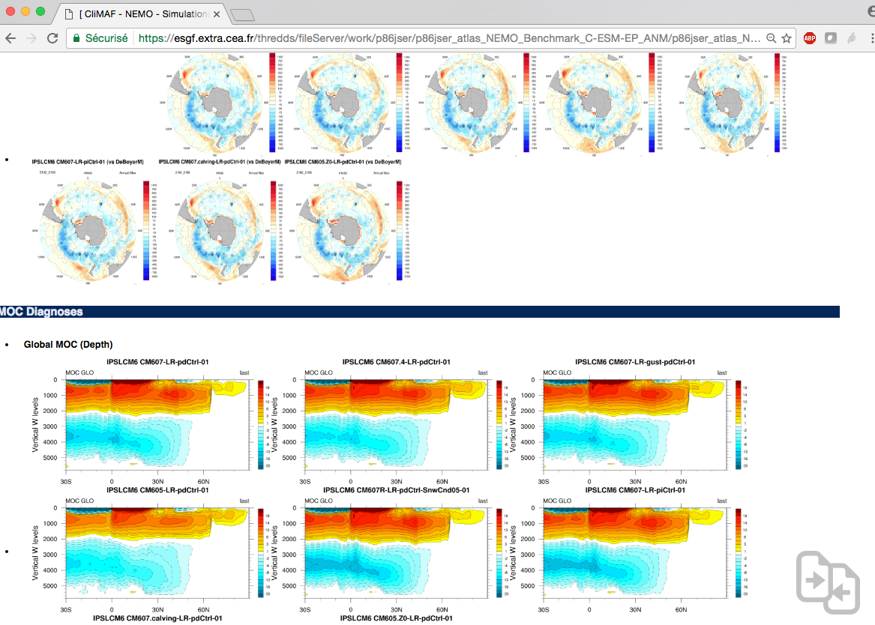
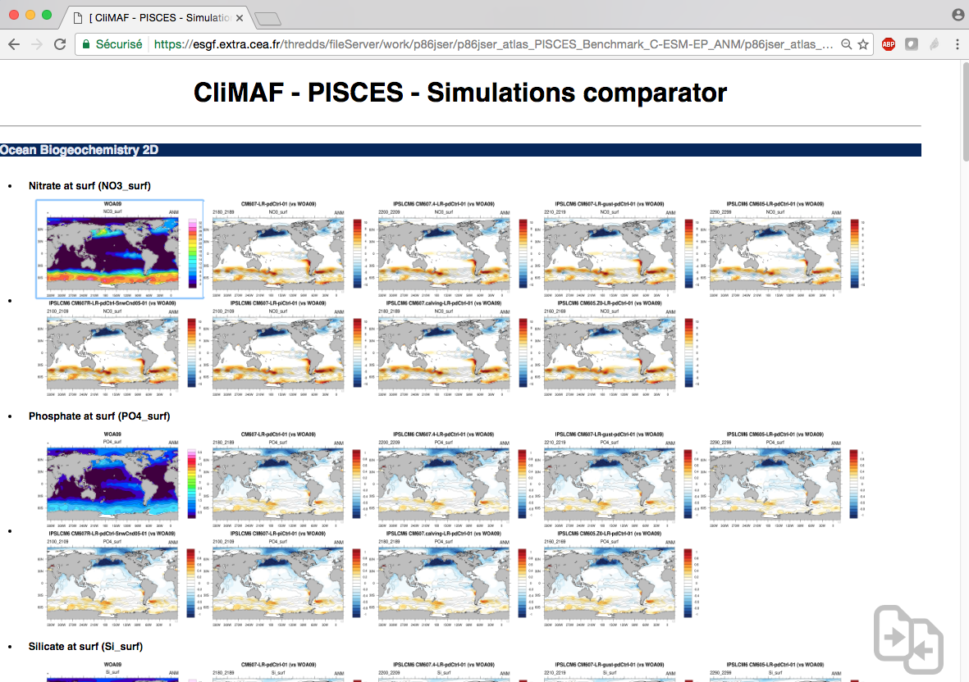
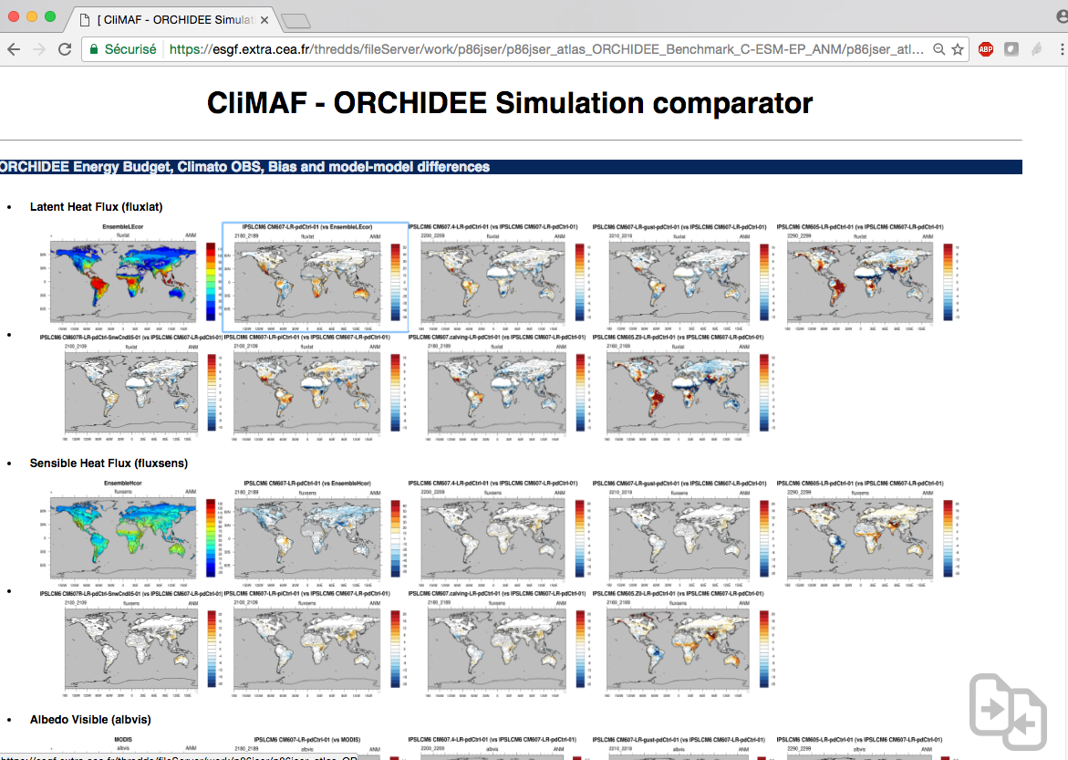
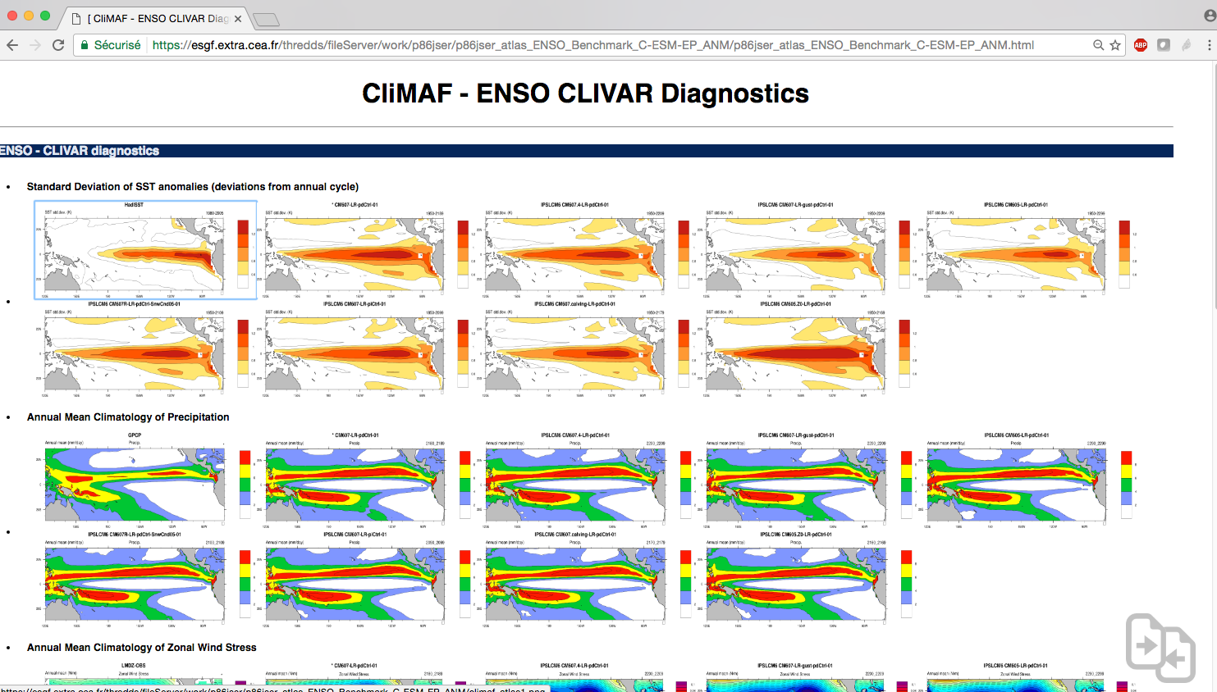
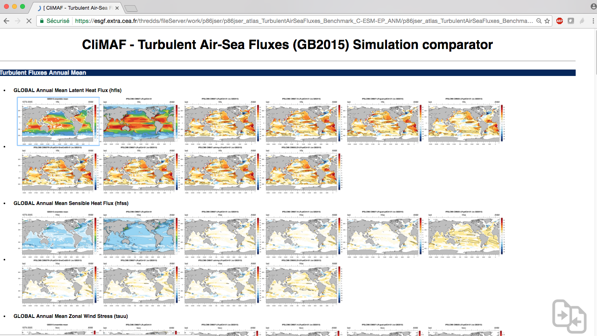
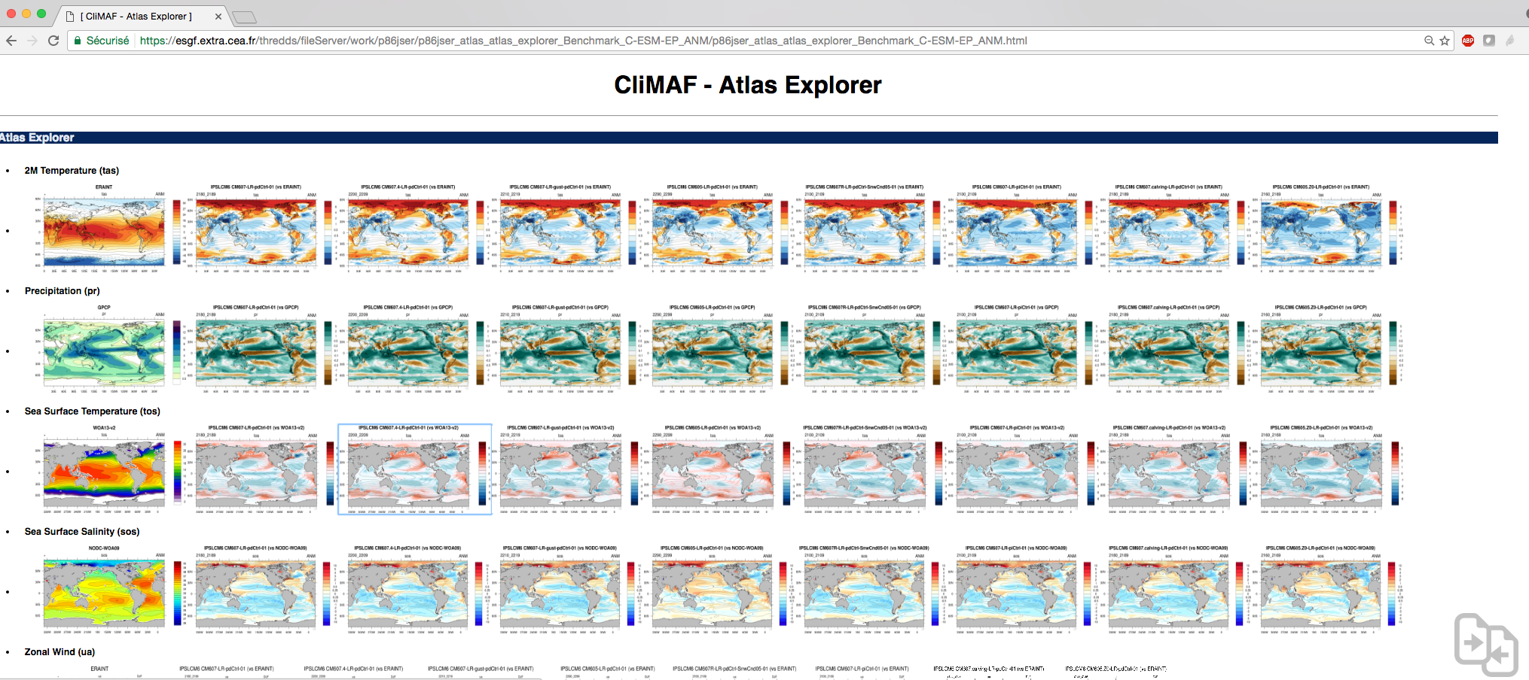

Slide 4
The C-ESM-EP is based on CliMAF (http://climaf.readthedocs.io/en/latest/), an advanced python framework developed in collaboration between CNRM-GAME and IPSL to provide the french community with an efficient way to gather-share diagnostics and apply them routinely on the climate models outputs.
S. Sénési, J. Servonnat, L. Vignon, O. Marti, P. Brockmann, S. Denvil
Contact: climaf@meteo.fr

Slide 5
Main strengths:
Standardised way to access the data => can be adapted to any CF-compliant netcdf files => encourage sharing the diagnostics!
Automatically manage the output in a smart cache (uses the existing results) => fast!
Simplified way to do those daily pretreatments (averaging, period/geographical domain selection, …) based on CDO
Easy way to do plots (using an NCL script) and put them in an html page
Easy to plug your own script of diagnostic
Main weaknesses:
it’s not magic! You will get errors at some point (sorry)
Potentially slows down when the cache is loaded with results

Slide 6
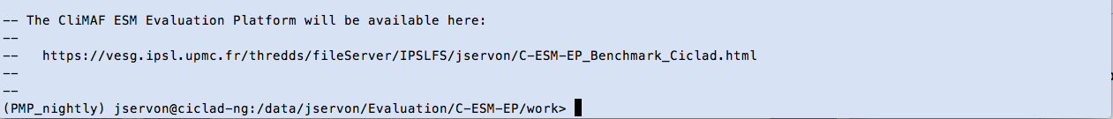
The C-ESM-EP in a nutshell
The quick way to use the C-ESM-EP on Ciclad
Copy the sources in a working directory:
cd my_working_directory
mkdir -p C-ESM-EP ; cd C-ESM-EP
cp –r ${sources} . ; cp –r src work
cd work
Setup your comparison:
cp -r comparison_example/ my_comparison/
Enter your datasets:
vi my_comparison/datasets_setup.py
Run all the components together or just a subset:
python run_C-ESM-EP.py my_comparison [Atmosphere_Surface,ENSO]
See the results on the URL returned by run_C-ESM-EP.py

Slide 7
‘CMIP5’ and ‘IGCM_OUT’ data access
Example of a CMIP5 and IGCM_OUT dataset definition
Definition of a CMIP5 dataset and an IPSLCM6 simulation (SE):
models = [
dict(
project = ’CMIP5’,
model = ’IPSL-CM5A-LR',
experiment = ’historical',
simulation = ’r1i1p1’,
frequency = ’monthly',
period = ’1980-2005'
),
dict(
project = 'IGCM_OUT’,
root = '/ccc/store/cont003/thredds',
login = 'p86caub',
model = 'IPSLCM6',
simulation = 'CM605-LR-pdCtrl01',
frequency = 'seasonal',
clim_period = '2020_2029'
)
]
More details on the data access in the demo/practicals.

Slide 8
Atlas Explorer
Definition
An easy and flexible working space within the C-ESM-EP to produce an html page showing climatologies and difference maps (with a reference) on a set of datasets (simulations, models, different periods…)
provide the user with a set of predefined features to assess a variable (plotting parameters, default observational reference) while keeping control on the diagnostics from only one parameter file.

Slide 9
Simulations – datasets
Variables (seasons, projections, domains…)

Slide 10
Atlas Explorer in a nutshell
The quick way to use Atlas Explorer on Ciclad
Install the C-ESM-EP and setup a comparison (as seen for the C-ESM-EP)
Go into the directory of your comparison and add your datasets in datasets_setup.py
cd my_comparison
vi datasets_setup.py
Edit the Atlas Explorer parameter file to setup what you need
vi AtlasExplorer/params_AtlasExplorer.py
Run the Atlas Explorer interactively:
./job_C-ESM-EP.py AtlasExplorer
See the results on the URL returned at the end of the execution.
Or submit a job from the main directory:
cd ../
python run_C-ESM-EP.py my_comparison/ AtlasExplorer

Slide 11
The compareCompanion
Display a selection of figures on the fly

Slide 12
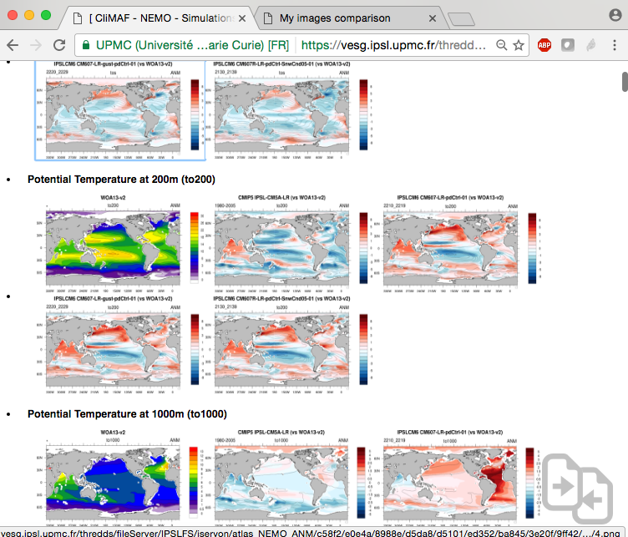
The compareCompanion
Display a selection of figures on the fly

Slide 13
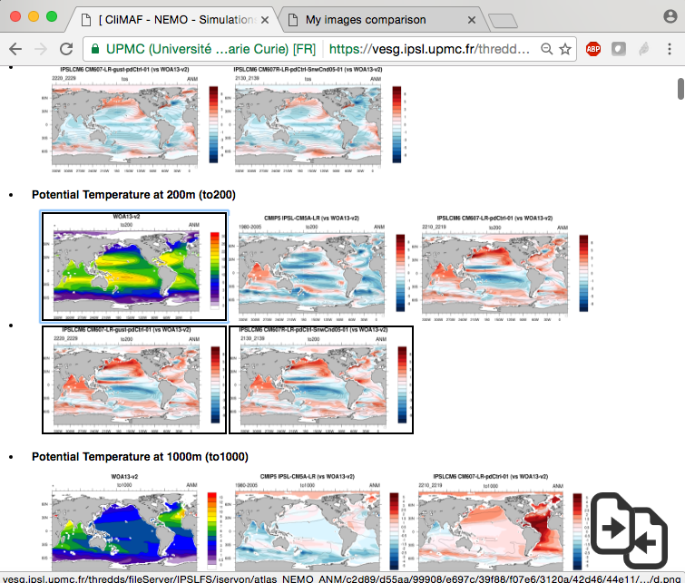
The compareCompanion
Select your figures with ‘s’
Select the images by putting the mouse over the plots and press ‘s’ (for ‘select’)
A black line is drawn over the selected plots

Slide 14
The compareCompanion
Select your figures with ‘s’
Click on the bottom right icon…

Slide 15
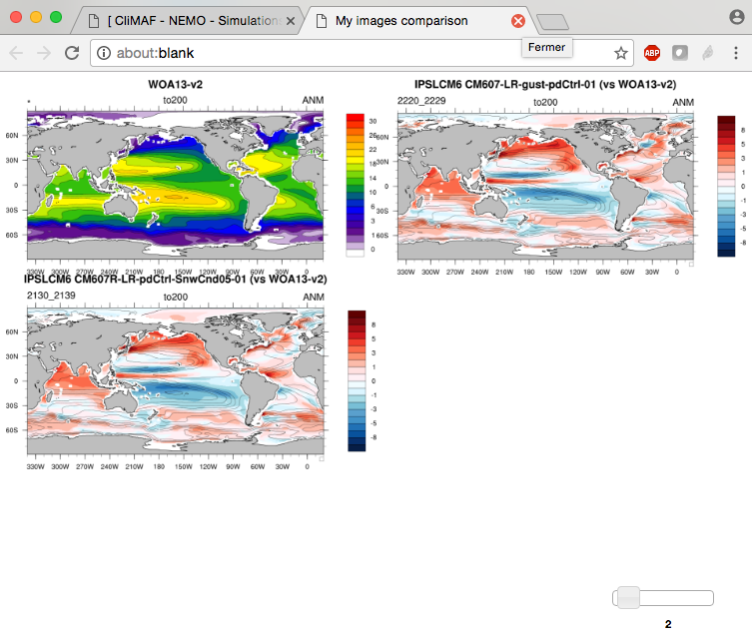
The compareCompanion
Display a selection of figures on the fly
Here is your selection of plots!
Control the number of columns with the slider…
And switch their positions by dragging the image you want at the position of your choice

Slide 16
Questions? jerome.servonnat@lsce.ipsl.fr

Slide 17
The CliMAF Earth System Model Evaluation Platform, 2017
J. Servonnat, S. Sénési, L. Vignon, O. Marti, P. Brockmann, S. Denvil
Contributors:
F. Hourdin, I. Musat, M.P. Moine, E. Sanchez, M. Chevallier, R. Msadek, J. Deshayes, M. Van Coppenolle, C. Rousset, J. Mignot, J. Ghattas, P. Peylin, N. Vuichard, P. Cadule, A. Ducharne, F. Maignan, R. Séférian
Beta-testers:
O. Marti, J. Mignot, J. Deshayes, P. Braconnot, P. Sepulchre, M. Kageyama, S. Denvil, R. Séférian, A. Cozic
The authors would like to give special credit to A. Voldoire for showing the way for CliMAF, and to F. Hourdin and the LMDz team for the structure of the C-ESM-EP that is largely inspired from the LMDz evaluation atlas.

